Slide 1
Special variables in Perl

Slide 2
Learning Objectives
Commonly used special variables
Examples

Slide 3
Perl special variables
Perl provides a set of pre-defined special variables
Provides a mean to type less and write compact codes
These variables generally use special characters like punctuation marks
Helps developers easily identify them from the normal variables.

Slide 4
Common special variable
Variable | Description
$_ | Default variable
$0 | Perl script name
$” | List separator
$, | Output filed separator
$. | Input line number
$/ | Input record separator
@_ | Default array
@ARGV | Command line arguments
http://www.perlmonks.org/?node_id=353259

Slide 5
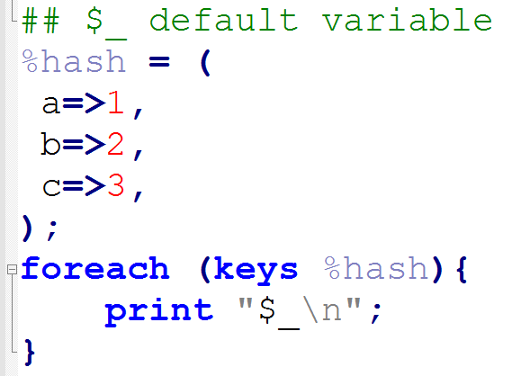
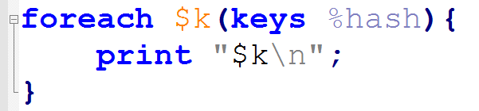
$_ : default variable
default input and pattern-searching space
default iterator variable in foreach()

Slide 6
$_ : default variable
functions that use $_ as a default argument
43 functions
abs, alarm, chomp, chop, chr, chroot, cos, defined, eval, evalbytes, exp, fc, glob, hex, int, lc, lcfirst, length, log, lstat, mkdir, oct, ord, pos, print, printf, quotemeta, readlink, readpipe, ref, require, reverse (in scalar context only), rmdir, say, sin, split (for its second argument), sqrt, stat, study, uc, ucfirst, unlink, unpack
default place to put the next value or input record
<FH>, readline(), readdir()

Slide 7
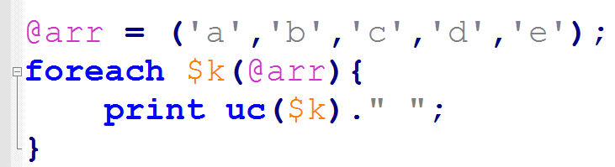
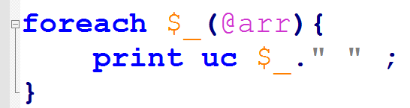
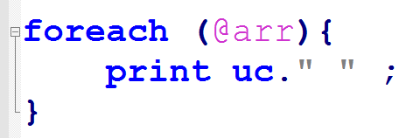

Slide 8
@ARGV
This is used to extract the commanline parameters passed to the script
It is just like an ordinary array
Predefined one.
We can modify the content manually.

Slide 9
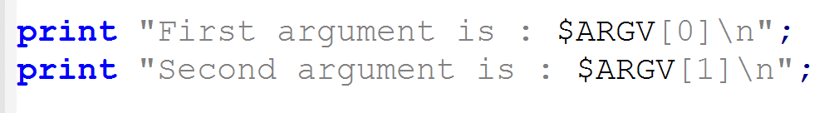

Argv.pl
$perl Argv.pl kanhu 28

Slide 10
perl copy.pl <file_name> <target_name>
use warnings;
use strict;
my $file = $ARGV[0]; ## First argument
my $file_o = $ARGV[1]; ## second argument
open IN, "< $file" or die "$!, $file"; # open in read mode
open COPY, "> $file_o" or die "$!, $file_o";# open in write mode
while ($line=<IN>){
print COPY $line ;
}
close IN; close COPY;

Slide 11
$! and $?
Stores run time error and warning messages
$? Stores error messages from a system() or backtick

Slide 12
$0 : Program name
Stores the name of the script
Useful for reusable script
Create usage information

Slide 13
$/ : Input record separator
Defines “what is a line”
Default value is newline.

Slide 14
use strict;
use warnings;
if($ARGV[0] eq '-h' or $#ARGV<0){
print STDERR "Script to read fasta file\nUsage: perl $0 FASTA\n";
exit(1); ## terminate program here
}
my $fasta = $ARGV[0];
my %h;
$/ = '>';
open F, "< $fasta" or die "$!: $fasta\n";
while(my $line=<F>){
$line=~s/>$//; ## as each seq separated by >
my @seq = split /\n/,$line;
my $id=shift @seq;
$h{$id}=join("",@seq);
}
close F;

Slide 15


Slide 16
use strict;
use warnings;
if($ARGV[0] eq '-h' or $#ARGV<0){
print STDERR "Script to read fasta file\nUsage: perl $0 FASTA\n";
exit(1); ## terminate program here
}
my $fasta = $ARGV[0];
my %h;
$/ = '>';
open F, "< $fasta" or die "$!: $fasta\n";
while(my $line=<F>){
$line=~s/>$//; ## as each seq separated by >
my @seq = split /\n/,$line;
my $id=shift @seq;
$h{$id}=join("",@seq);
}
close F;
AT1G51370.2 | MVAGADFA | AMCLKPAMS | MLKPOTY | MMAVNILY
0 | 1 | 2 | 3 | 4

Slide 17
$” and $, : Output list separator
Both work as array separator
$” : When an array is printed using a double quote.
$, : When an array is printed without interpolation in double quote.
Default values is space “ ”
We can change it to any other character.

Slide 18
## filter lines containing gene tag from Gff3 file
use strict;
use warnings;
if($ARGV[0] eq '-h' or $#ARGV<0){
print STDERR "Script to read gff file\nUsage: perl $0 GFF\n";
exit(1);
}
my $gff = $ARGV[0];
open F, "< $gff" or die "$!: $gff\n";
while(my $line=<F>){
my @record = split /\t/,$line; # split the line into an array
$"="\t";
print "@record" if $record[2] eq 'gene';
#$,="\t";
#print @record if $record[2] eq 'gene';
}
close F;

Slide 20
Thank you

